Slide 1
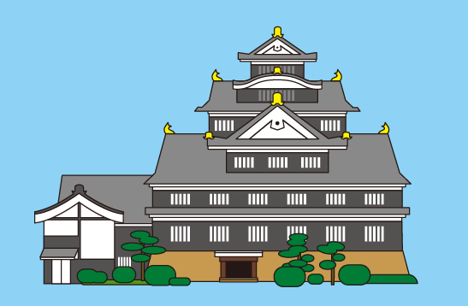
OKAYAMA
The City of Momotaro
OKAYAMA
*Momotaro is The Hero of Okayama

Slide 2
Main Features of Okayama
1. Good access
2. Charm of the region

Slide 3
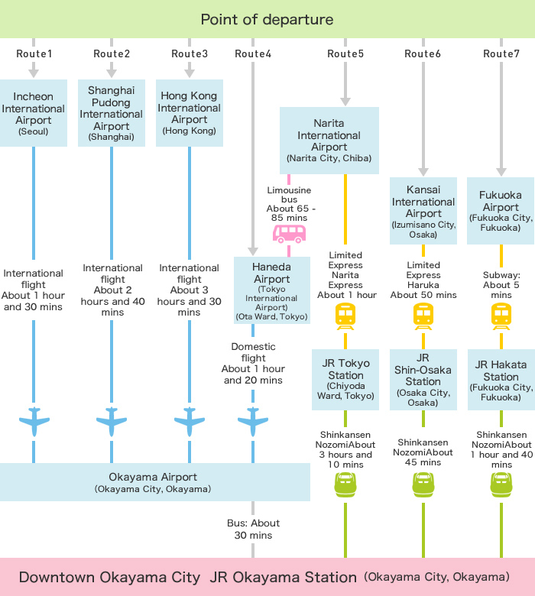
1. Good access (1)
(Access to Okayama City)
Regular flights from Seoul, Shanghai, and Hong Kong fly to Okayama Airport, and visitors can easily access Okayama City from major airports within Japan.
*2016.7.14~
Taiwan 3 flights weekly

Slide 4
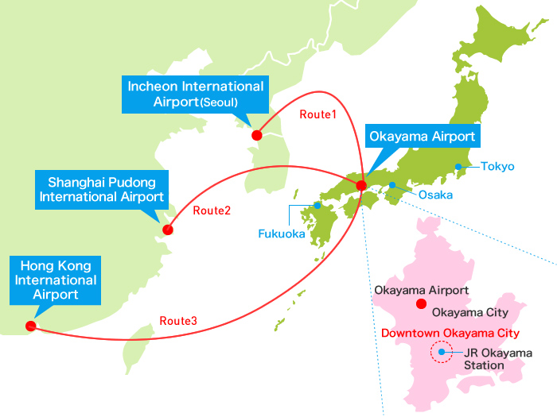
Routes 1, 2, and 3
Regular flights run from the Asian hub airports of Incheon International Airport (Seoul), Shanghai Pudong International Airport, and Hong Kong International Airport to Okayama Airport.
*2016.7.14~
Taiwan 3 flights weekly

Slide 5
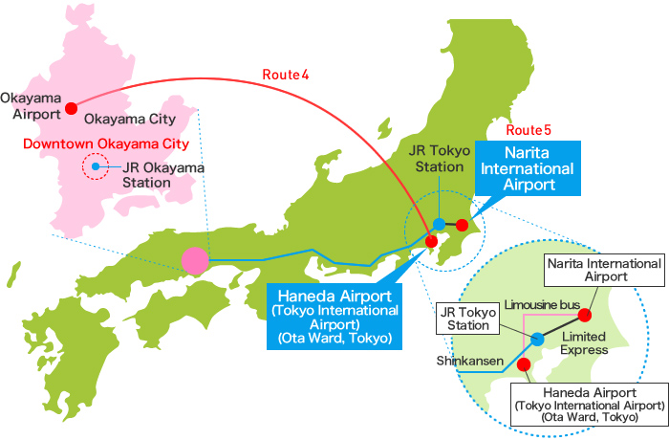
Routes 4 and 5
Domestic flights run from Haneda Airport (Tokyo International Airport) to Okayama Airport.
From Narita International Airport, visitors can take either the railway or shinkansen to Okayama City via Tokyo Station.
(Visitors can also take a limousine bus from Narita International Airport to Haneda Airport, then take a domestic flight to Okayama Airport.)

Slide 6
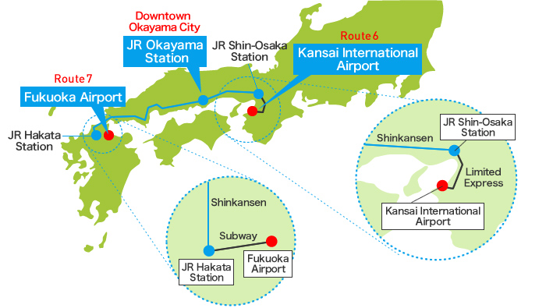
Routes 6 and 7
From Kansai International Airport, visitors can take either the railway or shinkansen to Okayama City via Shin-Osaka Station.
From Fukuoka Airport, visitors can take either the railway or shinkansen to Okayama City via Hakata Station.

Slide 7
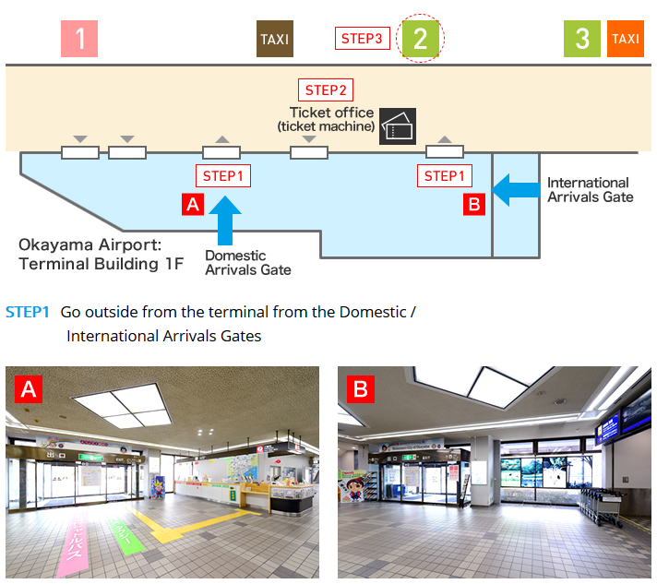
From Okayama Airport to Okayama Station (1)
Once you have finished the arrival procedures, go outside from the terminal. Follow the signs at the exit and proceed to the ticket office.

Slide 8
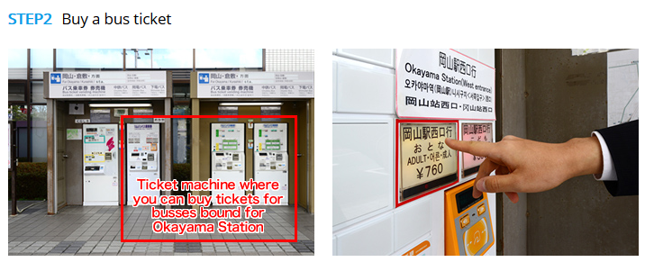
From Okayama Airport to Okayama Station (2)
Buy a ticket for a bus bound for Okayama Station at a ticket machine at the ticket office (760 yen). Refer to the sign posted at the top of the ticket machine for its operating instructions.

Slide 9
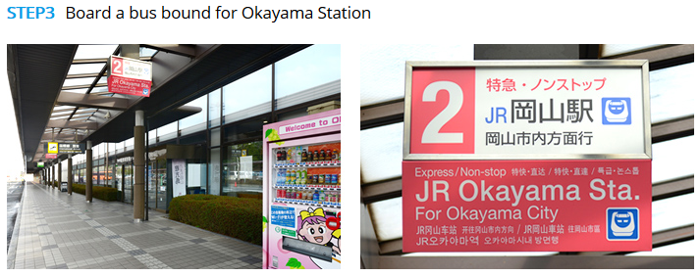
From Okayama Airport to Okayama Station (3)
Board a bus bound for Okayama Station, which departs from the No. 2 Bus Stop.

Slide 10
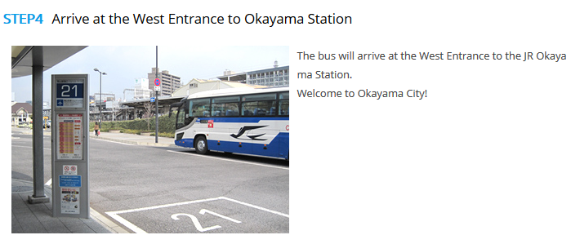
From Okayama Airport to Okayama Station (4)
The bus will arrive at the West Entrance to the JR Okayama Station.
Welcome to Okayama City!

Slide 11
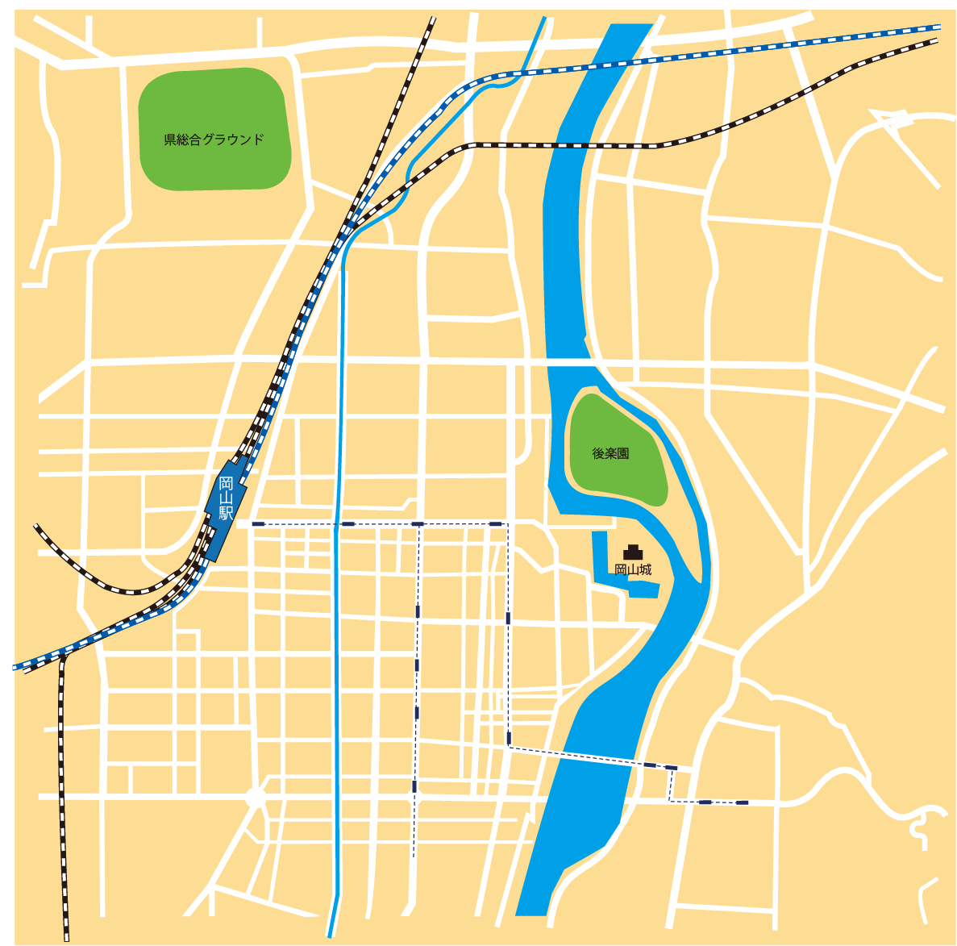
1. Good access (2)
(Location of hotels)
Within 1 km-radius of Okayama Station:
5000 hotel rooms for 6,700 guests
Okayama Castel
Total capacity of major hotels in the city:
approx. 9000 guests
Okayama station

Slide 12
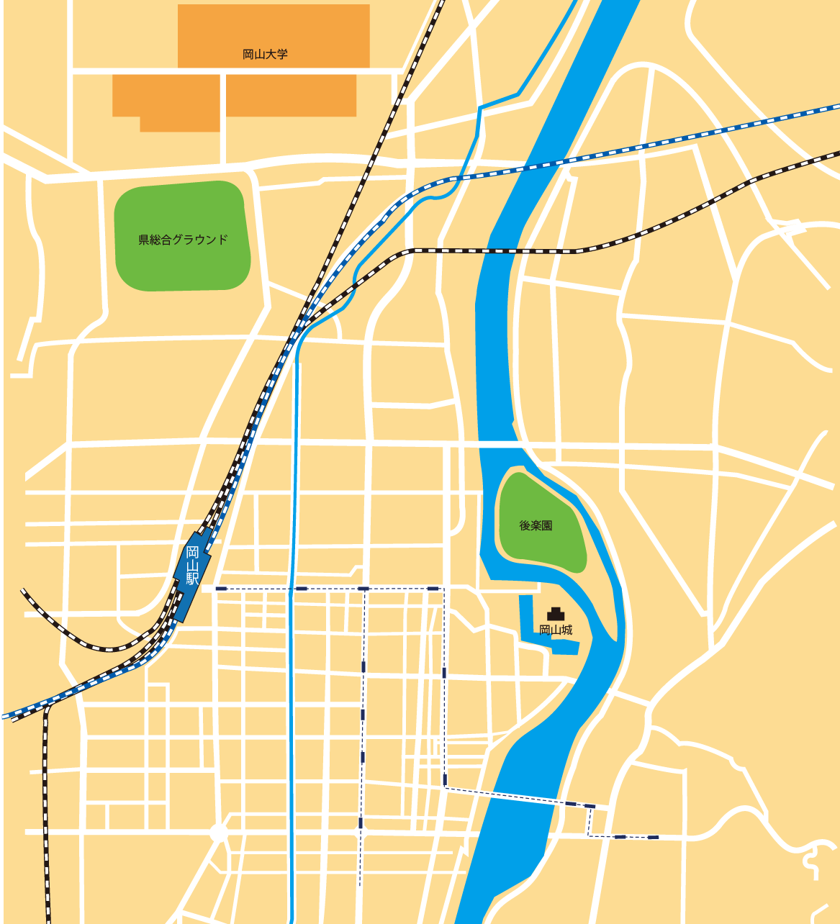
1. Good access (3)
(Location of convention complexes)
OkayamaUniversity
Area
There are 3 main areas where the convention complexes are located in Okayama city:
University Area - where various facilities of universities are located.
Cultural Area- where museums, Okayama Korakuen garden and Okayama Castle are situated.
Station Area- where Okayama Stations is conveniently located for good access to transportation.
A number of facilities are located in these areas to serve the different purposes of each convention.
Cultural Area
OkayamaStation
Area
1.9km・Walk25mit
Okayama station
Okayama Castel

Slide 13
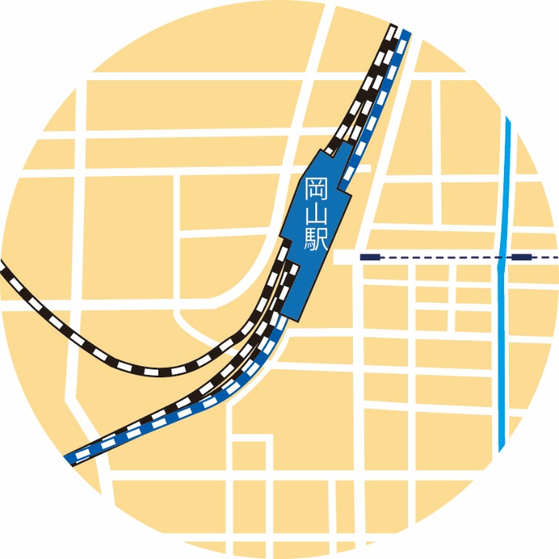
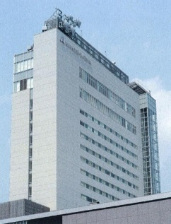
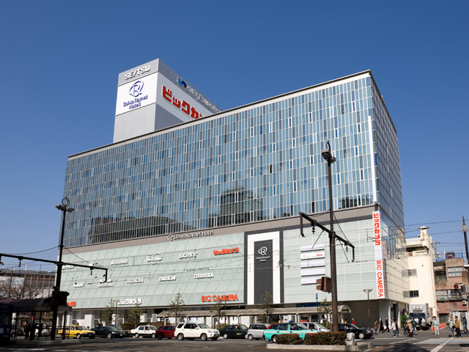
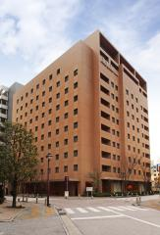
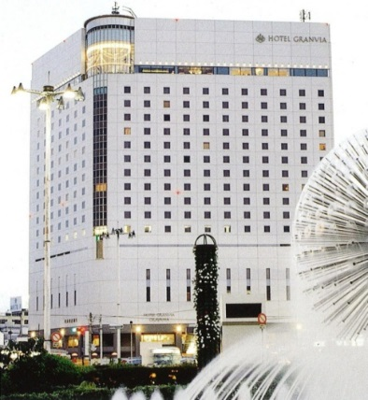
Okayama Station Area
Okayama Station
ANA Crowne Plaza
Hotel Okayama
Daiwa Roynet Hotel Okayama Ekimae
Mitsui Garden Hotel Okayama
Hotel Granvia Okayama

Slide 14
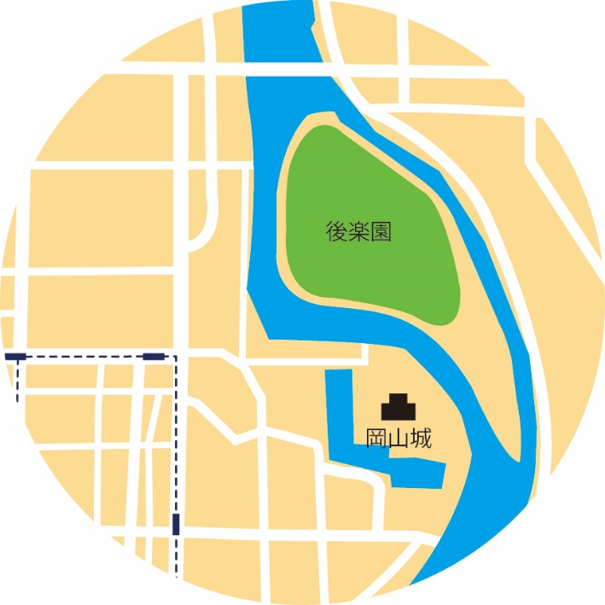
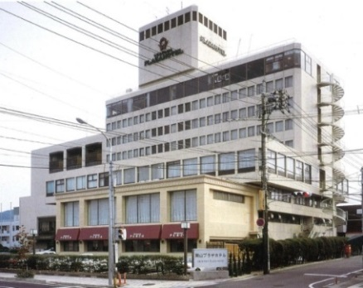
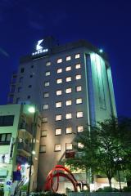
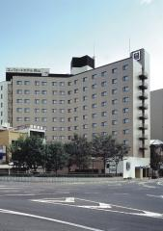
Cultural Area
Okayama Plaza Hotel
Hotel Excel Okayama
Okayama korakuen Garden
Comfort Hotel Okayama
Okayama Castel

Slide 15
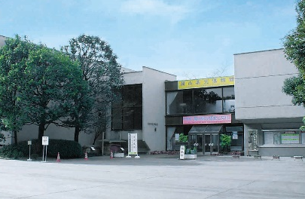
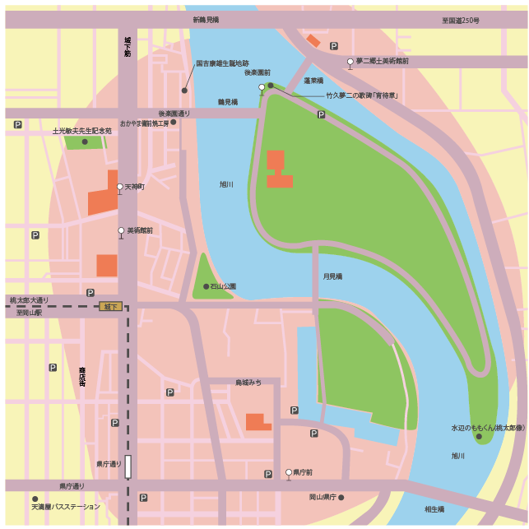
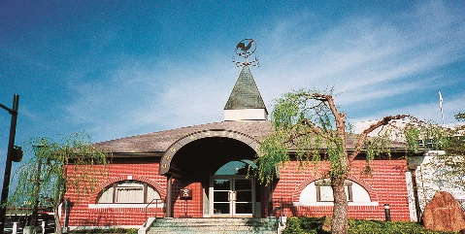
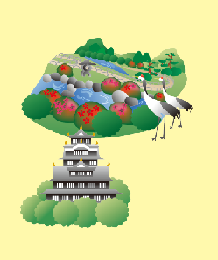
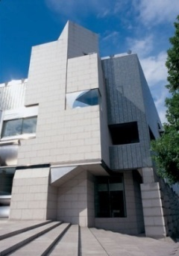
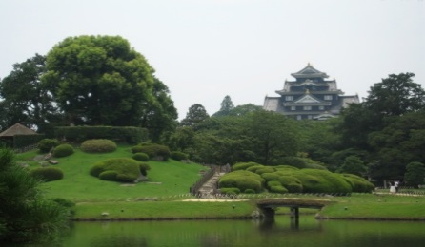
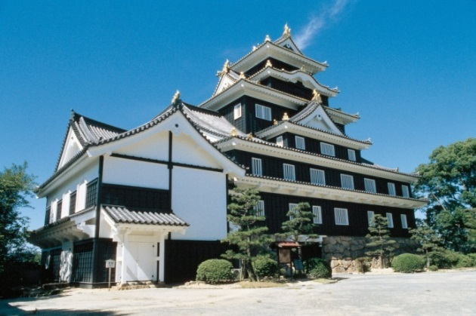
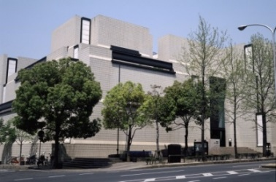
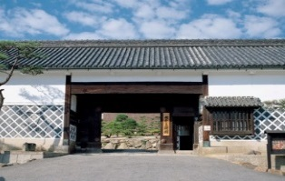
2. Charm of the region (1)
(Main sightseeing spots in Okayama city)
Yumeji Museum of Art
Okayama Plaza Hotel
Okayama Pref. Museum
Okayama Korakuen Garden
Okayama City
Comprehensive Welfare Hall
Okayama Pref. Museum of Art
Okayama Civic Center
日本三園
Okayama Symphony Hall
Hayashibara Museum of Art
Orient Museum
Okayama-Castle

Slide 16
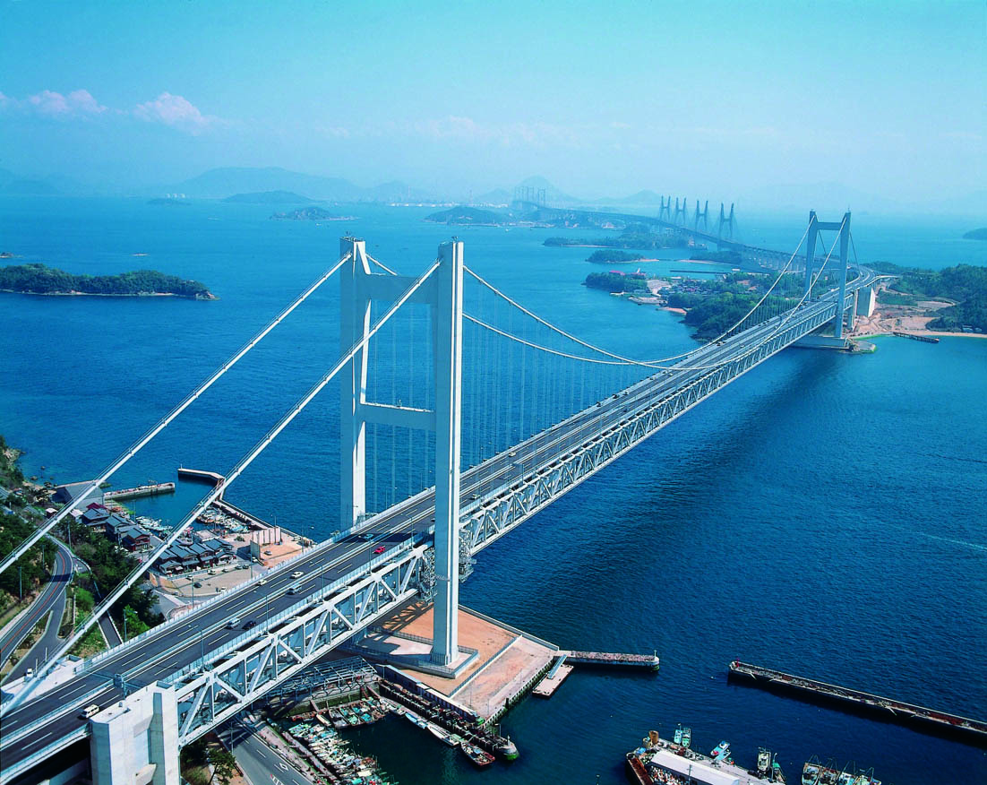
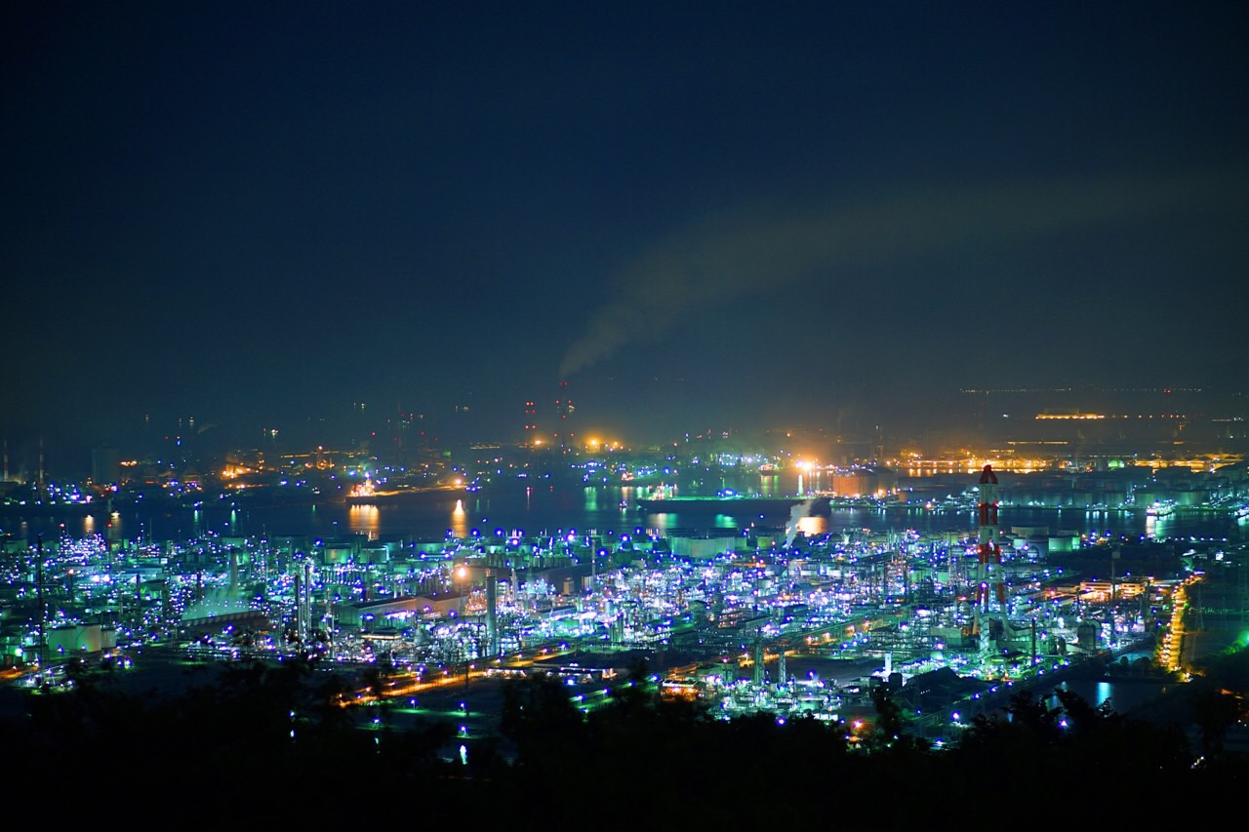
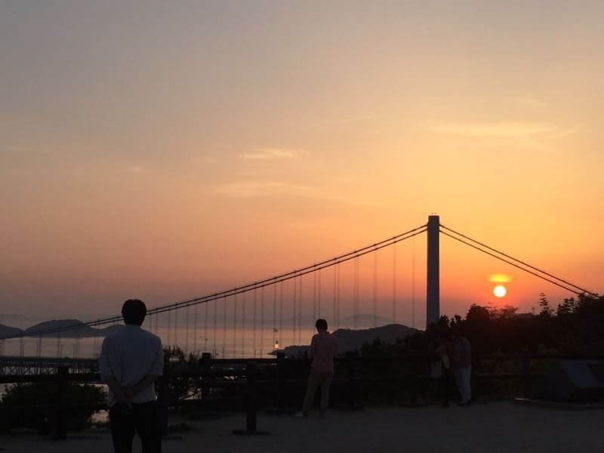
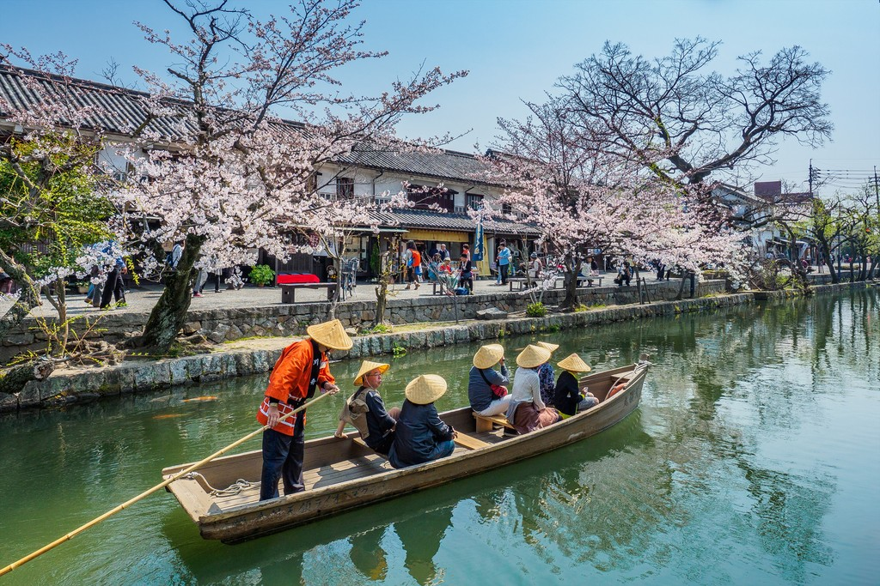
2. Charm of the region (2)
(Main surrounding sightseeing spots)
Kurashiki
Great Seto Bridge
It is easy to visit surrounding sightseeing spots from Okayama thanks to the convenient transportation. It takes only 15 minutes by train to get to famous old city, Kurashiki. You will be perfectly satisfied with such a large number of scenic sites within and just outside Okayama city.
Industrial complex
Sunset
Traditional Boat
Notes:
⑩
次は体験できるスポットの紹介です。日本のエーゲ海といわれるとても穏やかな瀬戸内海でシーカヤックの体験ができたり、電車で15分の倉敷エリアでは、島々を結ぶ瀬戸大橋の技術を身近に体験し、海面から175メートルの塔頂に登る体験ができます。その瀬戸大橋を山から眺める夕日も、外国人観光客には大変好評です。最後に、日本を代表する重化学コンビナートの夜景は、山頂からでも海上からでも望むことができ、とてもロマンチックな体験ができます。

Slide 17
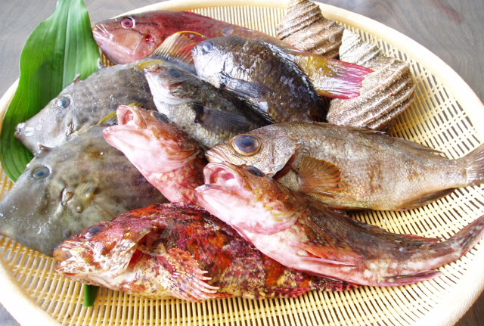
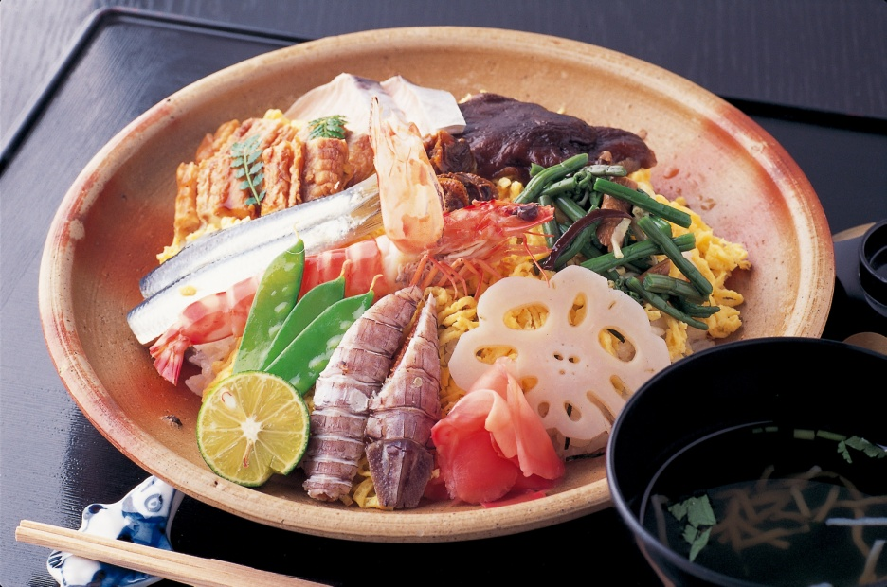
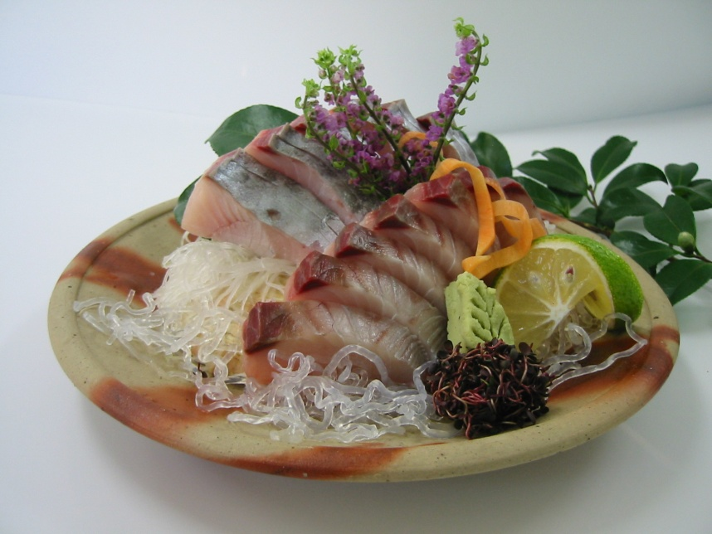
2. Charm of the region (3) (Dishes of Okayama)
魚
Bara Sushi
Fish from Seto
Enjoy country dishes in Okayama. There are a variety of fresh seafood dishes including fish from Seto Inland Sea, bara sushi, and sashimi of Japanese Spanish mackerel to name a few.
Fresh slices of raw Japanese Spanish mackerel

Slide 18
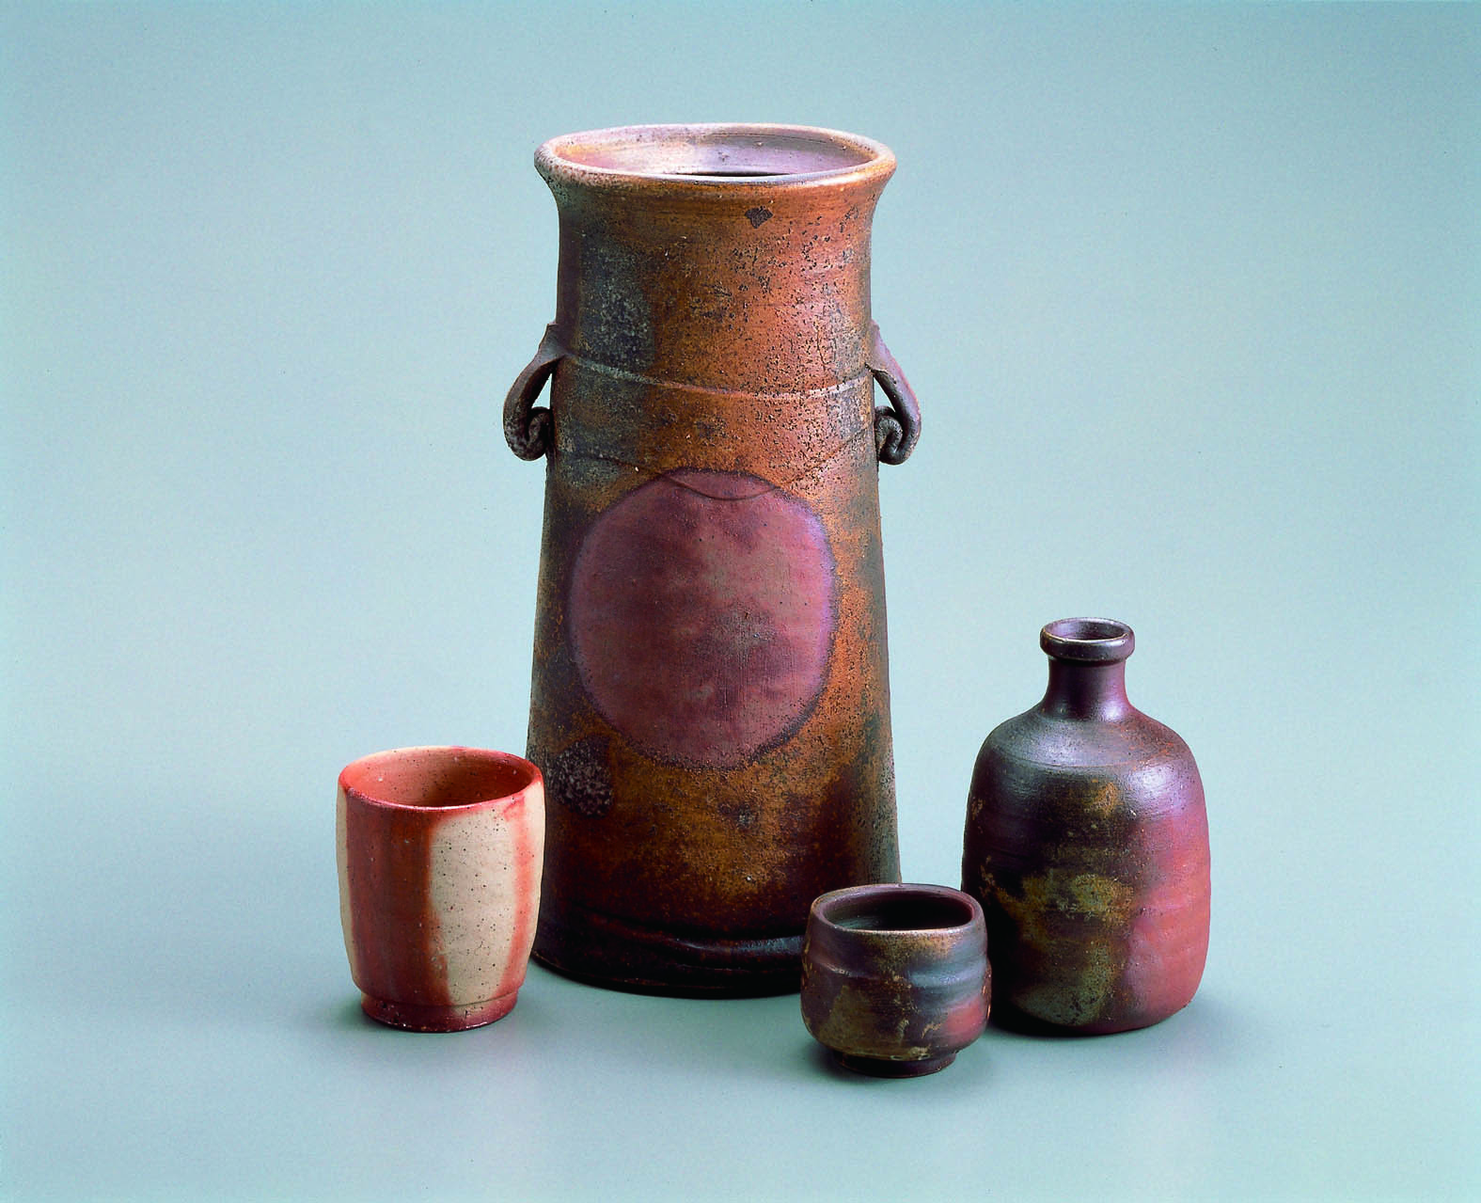
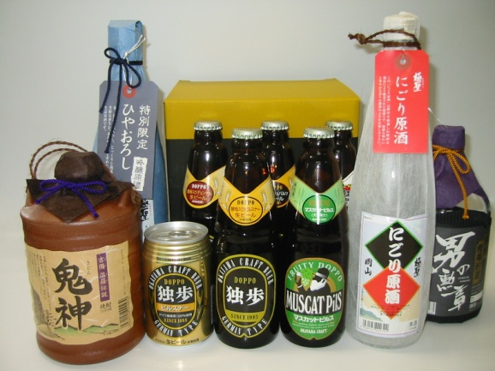
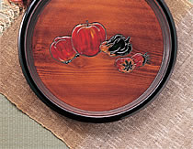
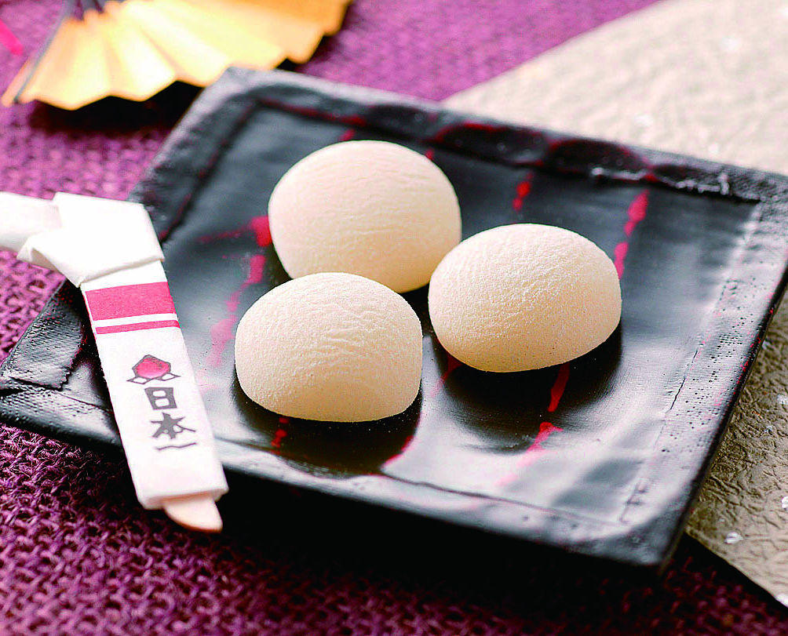
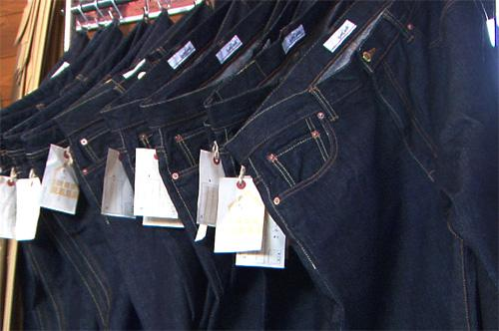
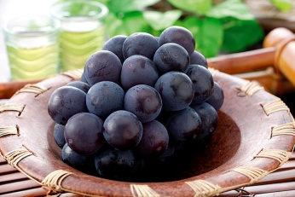
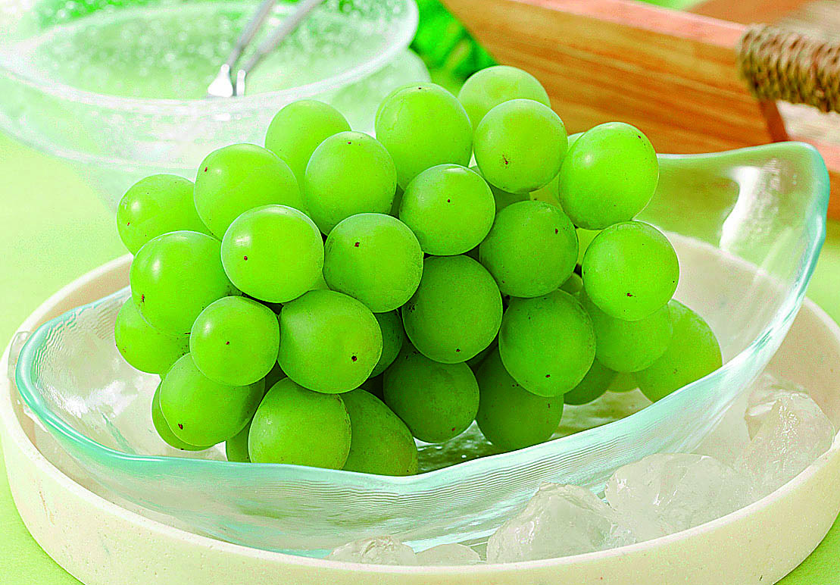
2. Charm of the region (4)
(Special products of Okayama)
Local Brew, Craft Beer
Ujobori woodcarving
Bizen ware pottery
Fruits
Proso Millet Cake
Jeans
Notes:
18

